Slide 1
Big Mountain Resort
Brett Gordon

Slide 2
Problem Statement
New chairlift adding $1.54 million in operating costs
How can Big Mountain Resort increase revenue to make up for these costs in the next ski season?
Focus on ticket prices
Use data related to 330 other resorts in the US
277 resorts had relevant data

Slide 3
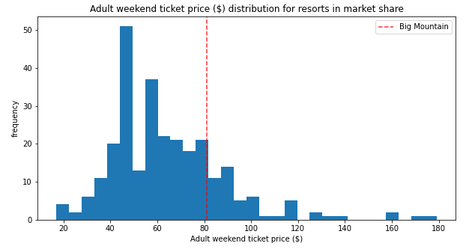
Solution
Increase ticket price from $81 to $95.87
Additional scenario to increase revenue
Extend vertical drop, adding a run to a point 150 feet lower down
Install additional chair lift
Add 2 acres of snow making cover
Increases ticket price by $1.99

Slide 4
Exploratory Data Analysis
Searched for relevant correlations
Focused on data related to states, including per capita and per square mile
Discovered relevant numerical categories
Total runs
Total chairs
Number of quad cars
Amount of snow making used
Amount of night skiing available

Slide 5
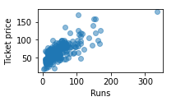
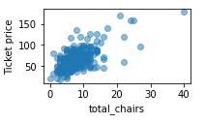
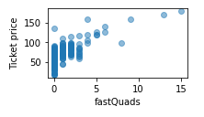
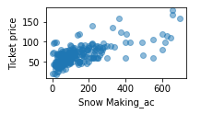
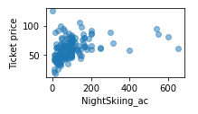
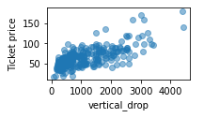
Exploratory Data Analysis

Slide 6
Preprocessing and Modeling
Confirmed through modeling the biggest positive features
Fast quads
Number of runs
Snow making
Vertical drop
Reasonable to increase ticket price to a range of roughly $85 to $106

Slide 7
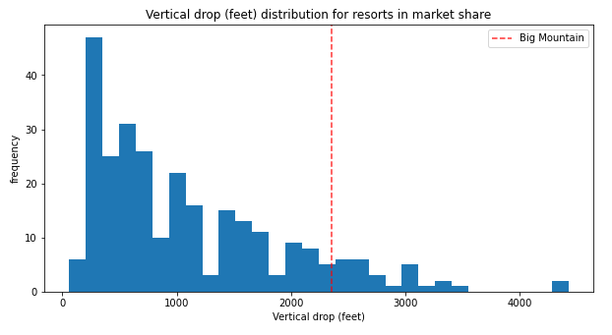
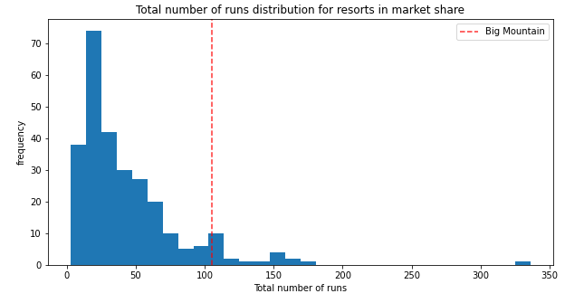
Modeling
There seems to be room for improvement in vertical drop and total number of runs

Slide 8
Conclusion
Adult ticket price for Big Mountain Resort should increase to about $96
Modeling suggests adding a run with a new chair lift, increasing the vertical drop and adding snow making
Scenario increases support for ticket price by $1.99
Expected revenue increase of over $3.4 million
Software program to be added for executives
Give ability to simply plug numbers for future scenarios

